Slide 1

Wireless Communication
ITA0321– MOBILE COMPUTING
GUIDED BY:
Dr. Manikandan Balasubramaniyam
PRESENTED BY:
R. JAYANTH

Slide 2
Introduction & Problem Statement
Introduction
Wireless communication transfers data between devices without physical cables using electromagnetic waves.
It is used in mobile phones, Wi-Fi, Bluetooth, and satellite communication.
Problem Statement
Wireless communication faces challenges such as signal interference, security risks, and limited bandwidth.
A reliable wireless system is needed to provide secure, fast, and uninterrupted connectivity

Slide 3
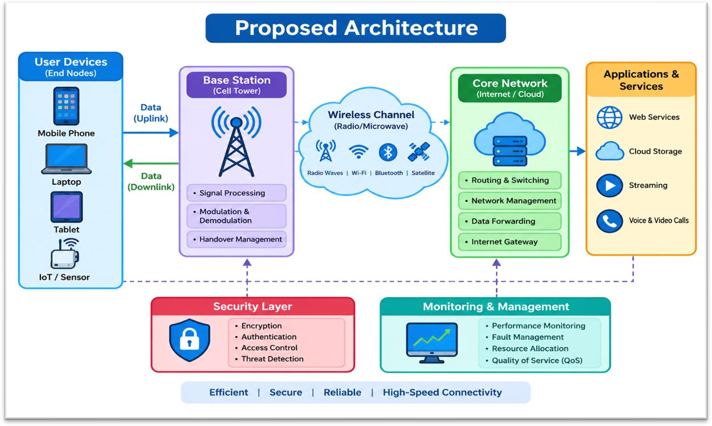
Proposed Architecture

Slide 4
Wireless Transmission & Propagation
Wireless Transmission: The transfer of data between devices without physical cables using electromagnetic waves.
Example: Sending data through Wi-Fi, Bluetooth, or mobile networks without cables.
Wireless Propagation: The movement of radio waves through air or space from a transmitter to a receiver via reflection, diffraction, and scattering.
Example: Radio signals traveling from a cell tower to a mobile phone.

Slide 5
Conclusion & Future Scope
Conclusion
Wireless communication enables fast and reliable data transmission without physical cables.
It supports mobile networks, Wi-Fi, IoT devices, and various digital services.
Future Scope
6G technology will improve data speeds, connectivity, and network performance.
AI, IoT, and satellite communication will enable smarter and wider wireless connectivity.

